Slide 1

DATA.AI Case study ERGIN AKIN – 13.04.2022

Slide 2
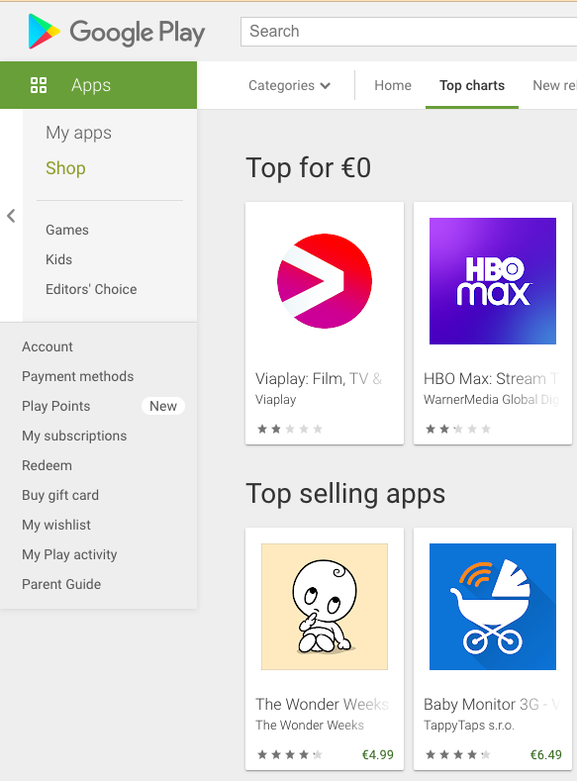
ASSIGNMENT COLLECTING PUBLIC DATA FROM APP STORE WEB PAGES
Vendors do not supply an API. We need to extract the data from their public web pages.
The main challenge is how to do this extraction and how to do this scalable for many categories and countries in a limited time interval.

Slide 3
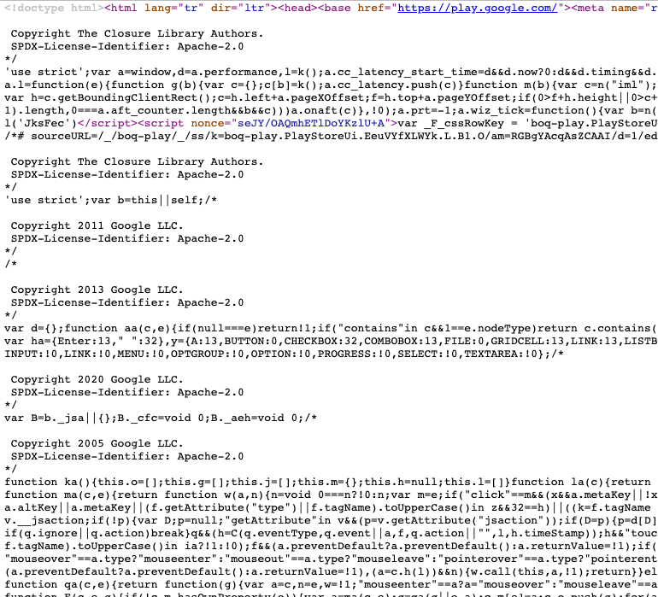
Challenges to extract information from web
Rendered for human reading
Page source is dynamic, references are unreliable
DOM is updated on the fly

Slide 4

How to extract the needed information from a web page
Selenium is a suite of tools for automating web browsers.
Primarily it is for automating web applications for testing purposes, but is certainly not limited to just that.
We can use this automation to navigate the web pages and extract the target information. We can also use Selenium in a loop to navigate to new pages based on the previous extracted information.

Slide 5

Working PoC
https://github.com/ergousha/app_rank
2 Lambda Python code + Serverless configuration
Lambda layer and Glue Data Catalog is missing in YAML

Slide 6
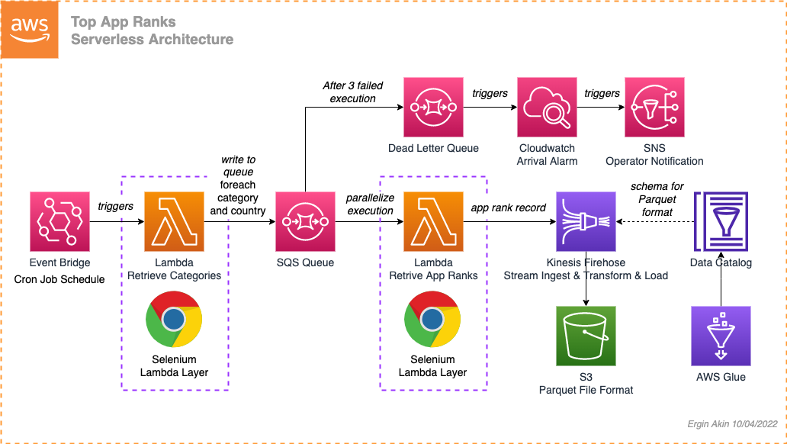
Notes:
Assume that data integrity and timely delivery is of of high importance
Explain which technologies would you use, and why?
How would you scale the system to collect these rankings for 100 countries?
How would you set up monitoring to ensure data integrity? What cases can you expect
with this data source?
If the interval needed to be hourly or every 20 minutes, how would that inform your decision on design?

Slide 7
About the three big data formats: Parquet, ORC and Avro
Storing data in its raw format would consume a lot of space and raw file formats cannot be accessed in a parallel manner. In data warehouses like Redshift, data is usually partitioned and compressed internally to make storage economical, make access fast and enable parallel processing. On Amazon S3, the file format you choose, compression mechanism and partitioning will make a huge difference in performance.
Data stored in ORC, Avro and Parquet formats can be split across multiple nodes or disks which means they can be processed in parallel to speed up queries. They compress the data so you need less space to store your data.
Parquet and ORC both store data in columns and are great for reading data, making queries easier and faster by compressing data and retrieving data from specified columns rather than the whole table.
Each data format has its uses. When you have really huge volumes of data like data from IoT sensors for e.g., columnar formats like ORC and Parquet make a lot of sense since you need lower storage costs and fast retrieval. But if you are considering schema evolution support or the capability of the file structure to change over time, the winner is Avro since it uses JSON in a unique manner to describe the data, while using binary format to reduce storage size. Avro has row-based data storage and excels at writing data.

Slide 8
How would you work around scraping prevention?
Check Network Tab First
Delays
User-Agent
Code and Response examples with/without User-Agent
Rotate User-Agents
Additional Headers
Ordered Headers
IP Rate Limit
Proxies
A python package selenium-stealth to prevent detection. This programme is trying to make python selenium more stealthy.

Slide 9
How would you abstract this system?

Slide 10

THANK YOU
Ergin Akin
erginakin@gmail.com

